Slide 1





This project has received funding from the Horizon Europe research and innovation programme under the Marie Skłodowska-Curie Grant Agreement No. 101119635
This project has received funding from the Horizon Europe research and innovation programme under the Marie Skłodowska-Curie Grant Agreement No. 101119635

Slide 2

Deep Learning xAI
Faizan Ahmed

Slide 3
Deep Learning
Learns features directly from raw data (no manual feature design).
Works well with images, audio, text, and high-dimensional data.
Why it’s powerful:
Learns filters/features automatically.
Decides which parts of the input are important.
Examples:
Dense Neural Networks (DNNs)
Convolutional Neural Networks (CNNs)
Autoencoders (AE, VAE)
Generative Adversarial Networks (GANs)
Graph Neural Networks (GNNs)

Slide 4
XAI for Deep Learning
Most model agnostic methods such as local models or partial dependence plots are applicable
Why special XAI methods for deep learning
neural networks learn features and concepts in their hidden layers, and we need special tools to uncover them
the gradient can be utilized to implement interpretation methods that are more computationally efficient than model-agnostic methods that look at the model “from the outside”

Slide 5
XAI for Deep Learning
Input output mapping is beyond human perception
Many layers of multiplication
Millions of weights
Multiple non-linear transformations
The main idea:
The methods visualize features and concepts learned by a neural network, explain individual predictions and simplify neural networks.
Two main questions
Which features are learned and where?
How to visualize them?

Slide 6
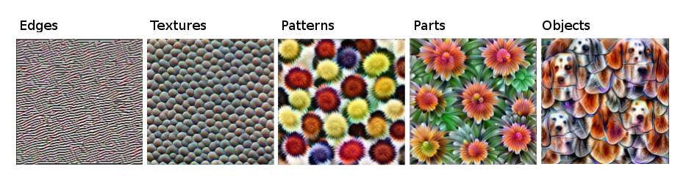
Learned Features
First layers: edges & colors
Middle layers: textures & shapes
Deep layers: object parts & concepts

Slide 7
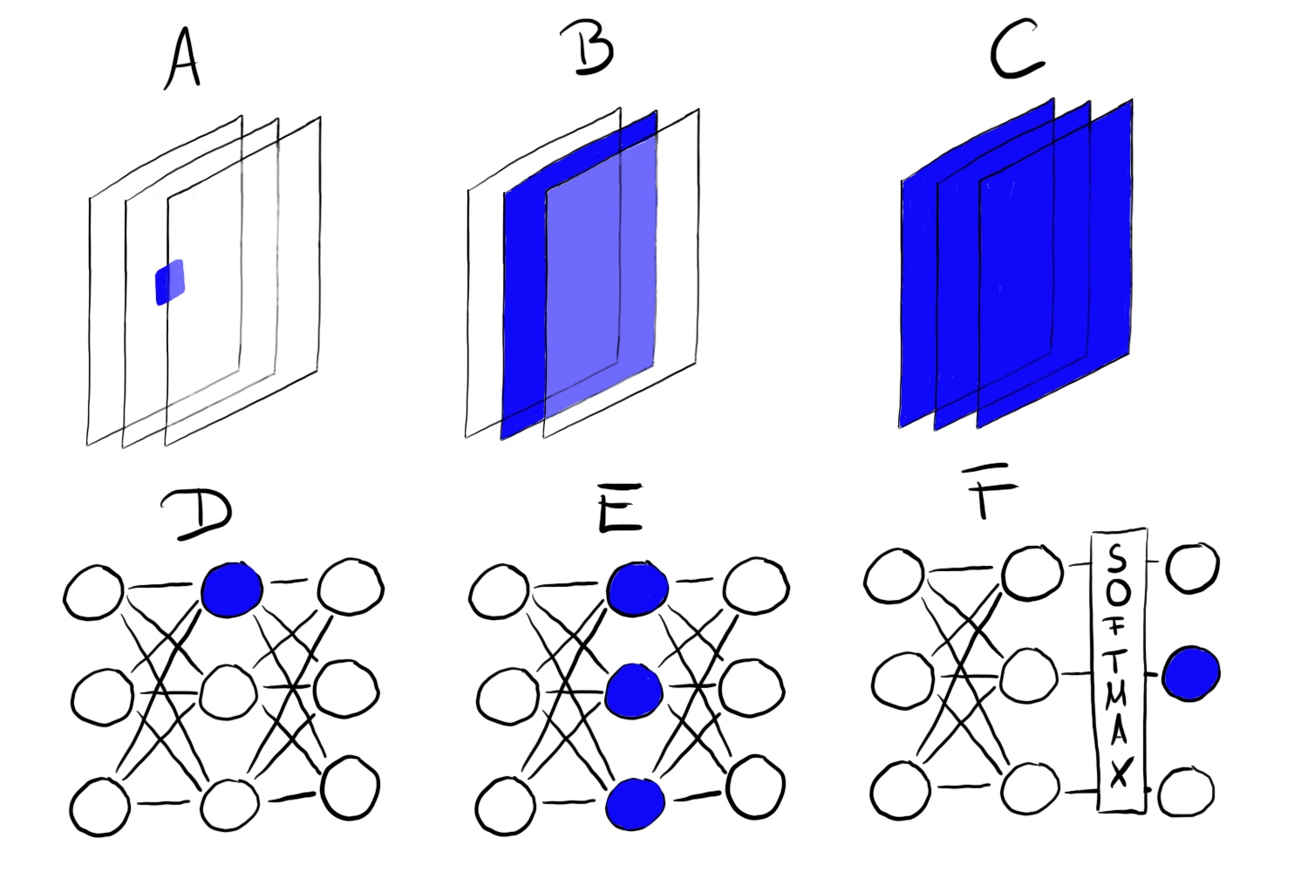
Feature Visualization
Feature visualization reveals learned features by finding the input that maximally activates a specific neural network “unit”.
“Unit”
Convolution neuron,
Convolution channel, Convolution layer, Neuron,
Hidden layer,
Class probability neuron (or corresponding pre-softmax neuron)

Slide 8
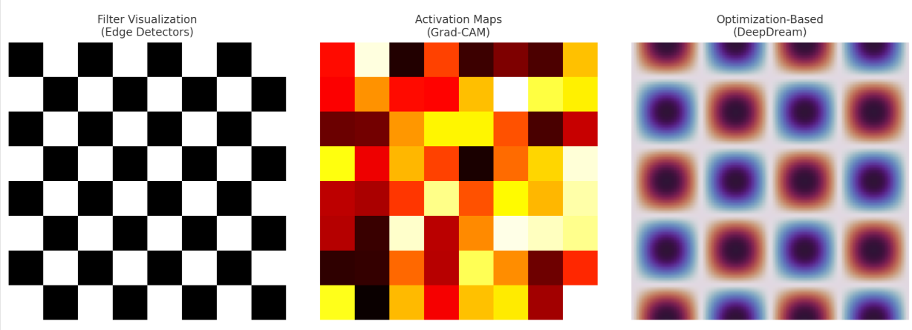
Feature Visualization Methods
Optimization-based (DeepDream, activation maximization) → ideal inputs
Activation maps (CAM, Grad-CAM) → where the network looks
Filter visualization → see what filters learn

Slide 9
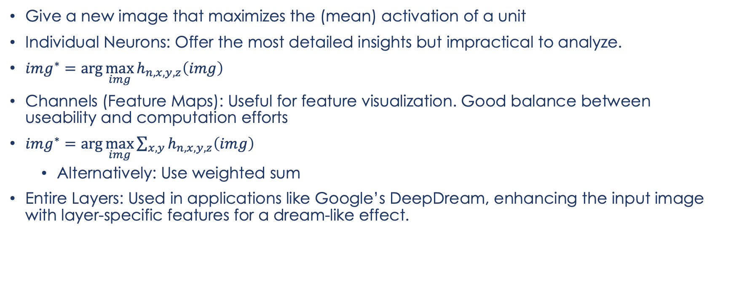
Optimization-based
Give a new image that maximizes the (mean) activation of a unit
Individual Neurons: Offer the most detailed insights but impractical to analyze.
$img^{∗}=\arg{\max_{img}{h_{n,x,y,z}\left(img\right)}}$
Channels (Feature Maps): Useful for feature visualization. Good balance between useability and computation efforts
$img^{∗}=\arg{\max_{img}{\sum_{x,y}{h_{n,x,y,z}\left(img\right)}}}$
Alternatively: Use weighted sum
Entire Layers: Used in applications like Google’s DeepDream, enhancing the input image with layer-specific features for a dream-like effect.
Notes:
$h$ is the activation of a neuron.
Img the input of the network (an image)
X and y describe the spatial position of the neuron
N specifies the layer
Z is the channel index
Feature visualization can be done for different units. A) Convolution neuron, B) Convolution channel, C) Convolution layer, D) Neuron, E) Hidden layer, F) Class probability neuron (or corresponding pre-softmax neuron)

Slide 10
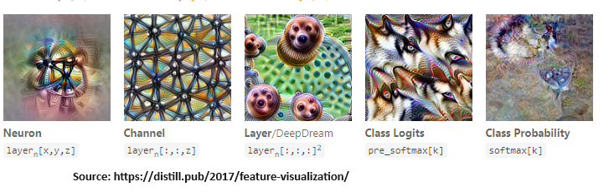
Optimization based
DeepDream / Activation Maximization: generate images that maximize activations
Visualizations reveal what neurons, channels, or classes respond to most strongly.

Slide 11
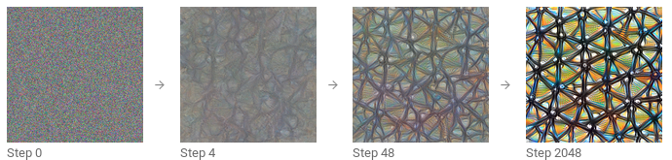
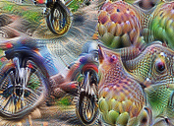
Optimization based
Maximizing vs. minimizing activations shows what excites or suppresses a neuron/unit.
Ways to find images:
Existing images: find samples that strongly activate a unit
Limitation: may reflect dataset correlations, not true focus.
Generated images: optimize from noise with constraints
Techniques: jitter, rotation, scaling, regularization.
Notes:
FIGURE 10.3: Positive (left) and negative (right) activation of Inception V1 neuron 484 from layer mixed4d pre relu. While the neuron is maximally activated by wheels, something which seems to have eyes yields a negative activation.

Slide 12
Feature Visualization
Advantages
Qualitative insight into what individual units respond to (edges, textures, object parts)
Hypothesis generation for which features a network might use
Guides further analysis (e.g. suggests concepts to test with Network Dissection)
Disadvantages
No proof-of-concept learning: seeing “skyscraper-like” patterns doesn’t guarantee the unit actually detects skyscrapers
Lacks a quantitative score for how reliably a unit detects a given concept
Entanglement risk: real concepts often spread across many channels, so single-unit visualizations can be misleading

Slide 13
Feature Visualization
Feature Visualization Complexity
Many feature visualizations are abstract, lacking clear links to understandable human concepts.
Displaying feature visualizations alongside training data often provides limited insight, indicating only general attributes like color presence (e.g., "requires yellow").
Volume of Data
High volume of units makes comprehensive analysis impractical:
Over 5000 channels across nine layers in Inception V1.
Visualizing both positive and negative activations, plus training images, could require displaying over 50,000 images.
Interpretability Issues
Feature visualizations can create an illusion of understanding neural network operations.
Complex interactions and lack of clear concept linkage make true interpretability elusive:
Many units do not correspond to any human-recognizable concept.
Positive and negative activations often indicate unrelated features.

Slide 14
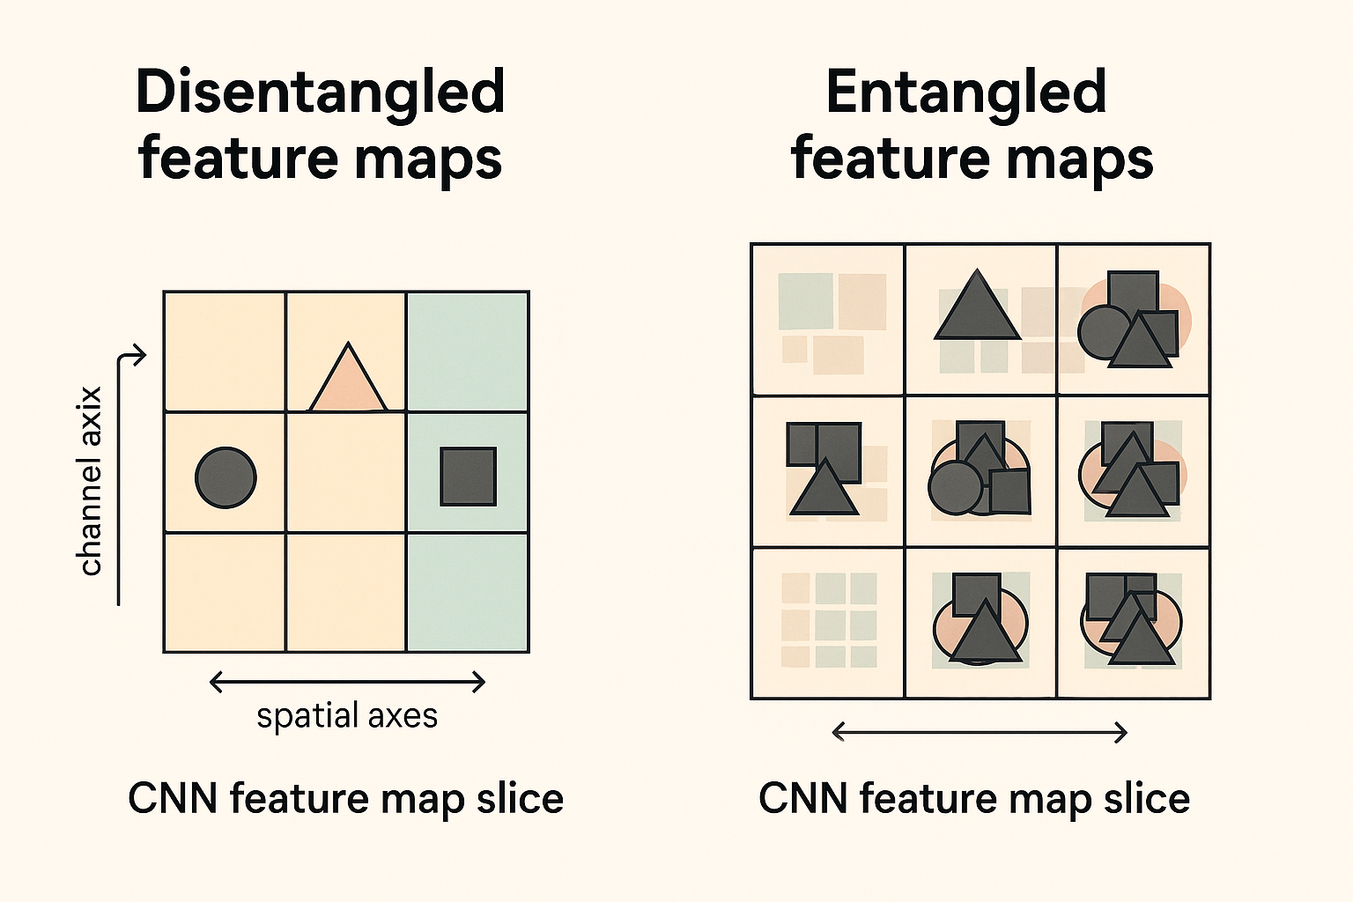
Network Dissection
Disentangled feature: A single unit/channel ⇢ a single real-world concept
e.g. channel 394→skyscrapers, 121→dog-snouts, 12→30° stripes
Entangled features: concepts spread across many channels
Assumption Feature Visualization: Units of a neural network (like convolutional channels) learn disentangled concepts.

Slide 15

Network Dissection
Convolutional neural networks are not perfectly disentangled.
A way to go: quantify the interpretability of a unit of a convolutional neural network.
links highly activated areas of CNN channels to human-understandable concepts like objects, colors, and textures.

Slide 16
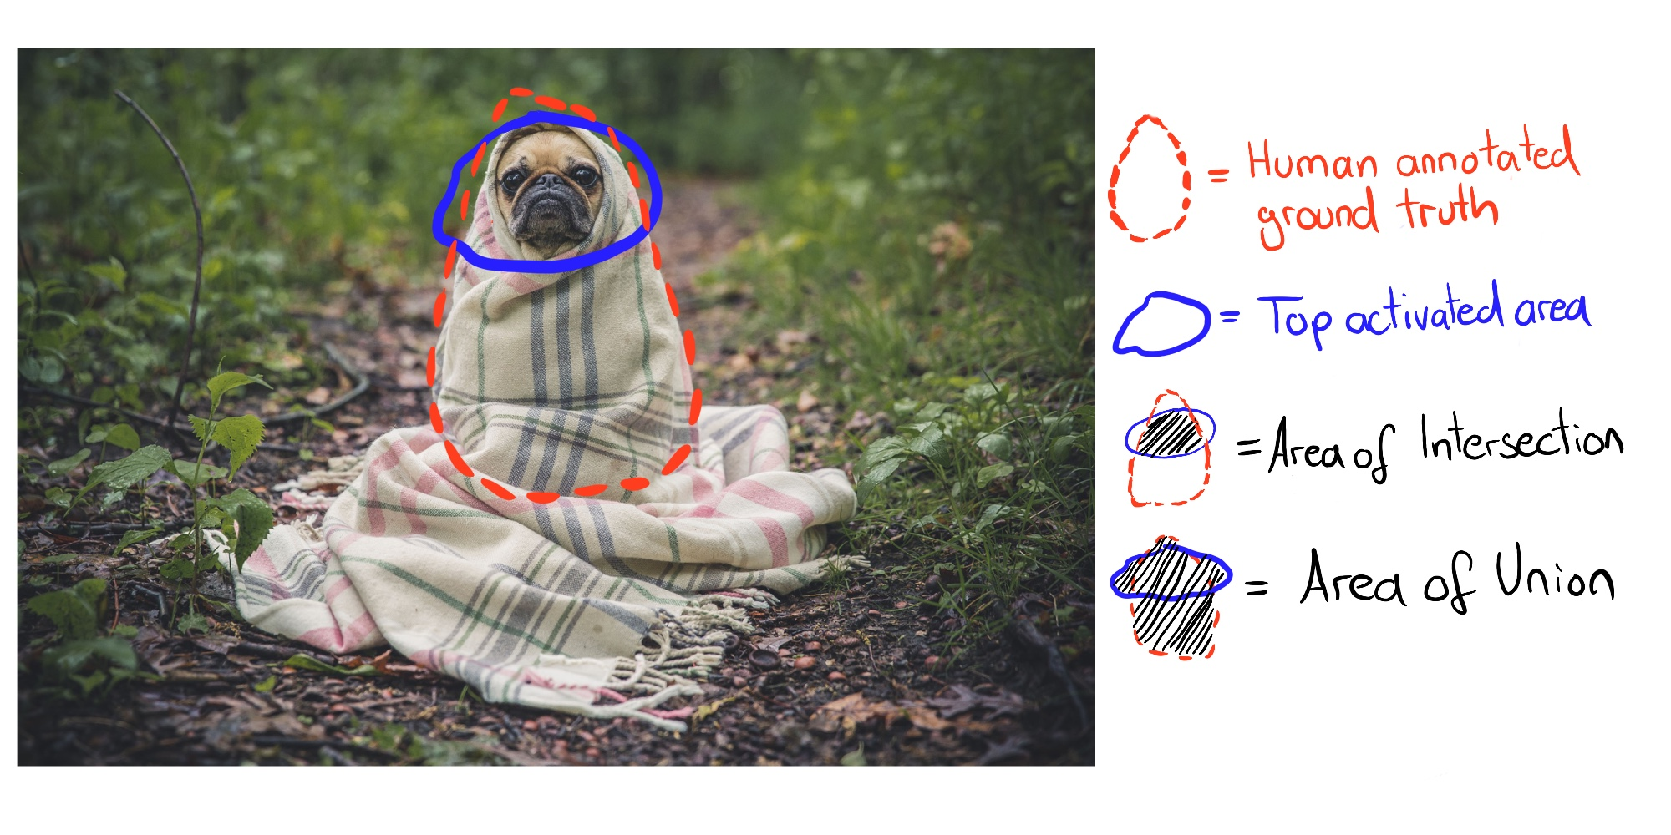
Network Dissection
Get
Get images with human-labeled visual concepts, from stripes to skyscrapers
Measure
Measure the CNN channel activations for these images.
Quantify
Quantify the alignment of activations and labeled concepts.

Slide 17
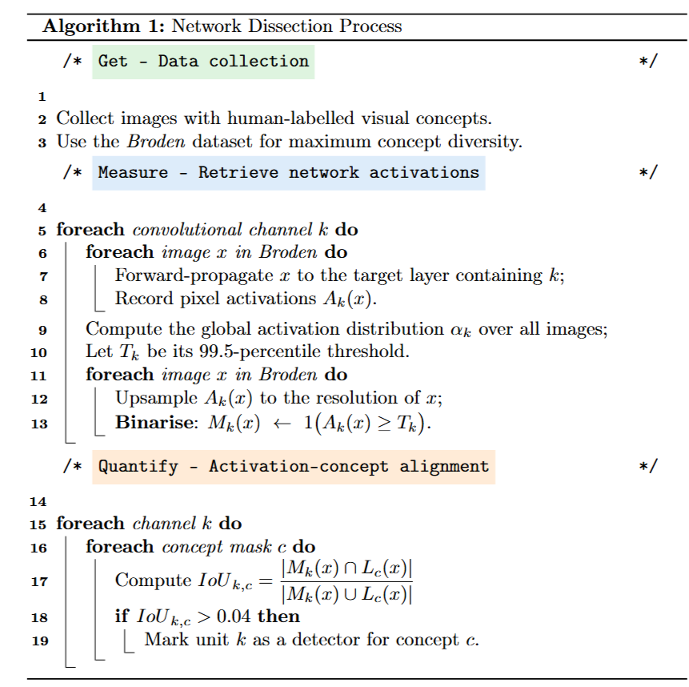
Network Dissection
Step 1: (Get) Broden dataset
Step 2: (Measure) Retrieve network activations
Step 3: (Quantify) Activation-concept alignment

Slide 18
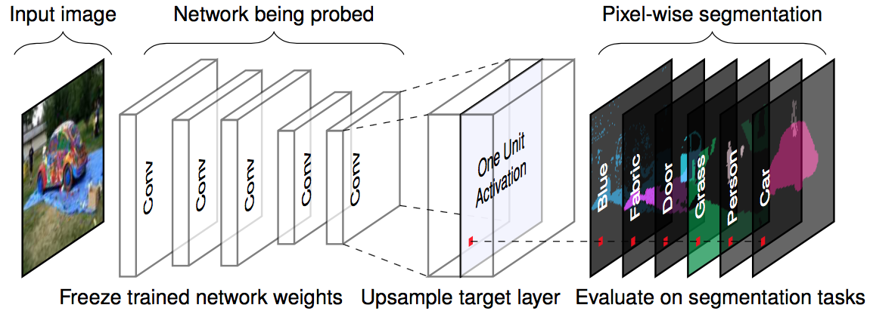
Network Dissection
quantifies the interpretability of a unit of a convolutional neural network.
Notes:
1 Title & one‑sentence takeaway
“Network Dissection quantifies how interpretable each hidden unit in a CNN is.” Make sure people first understand that the method produces a number (IoU‐based) telling you whether a filter lines up with a human‑named concept like tree, door or texture.
2 Left block — Input image
Start with the photograph on the left.
Explain that you will feed unseen, natural images into a frozen, pretrained network (no fine‑tuning at this stage).
3 Centre block — Network being probed
Point to the stack of grey “Conv” boxes.
Emphasise “freeze trained network weights” written underneath. Why? You want to measure, not change, what the network already knows.
Pick one target layer (often the last convolutional layer) whose units you’ll probe.
4 Zoom‑in block — One Unit Activation
The dashed arrows zoom into a single channel (one filter) in that layer.
Mention that its activation map is lower‑resolution than the input, so you upsample it back to input size (bilinear or nearest‑neighbour).
5 Right block — Pixel‑wise segmentation evaluation
The coloured slices labelled blue, fabric, door, grass, person, cat are ground‑truth semantic masks from a dense‑label dataset (Broden dataset in the original paper).
You overlay the upsampled activation on each mask and compute Intersection‑over‑Union (IoU).
High IoU → the unit consistently fires where that concept appears.
Do this for every unit × every concept, then record the best‑matching concept (or “none”).
6 Why it matters
Counting how many units match distinct concepts gives an Interpretability score for the architecture/training regime.
Lets you compare networks (e.g., BatchNorm vs. no BatchNorm, self‑supervised vs. supervised) without subjective visuals.
7 Suggested wording for a single‑slide pitch
“We freeze a pretrained CNN, feed in natural images, zoom into one filter’s activations, upsample them, and see whether that heat‑map lines up with human labels such as door or grass. The IoU of that overlap becomes a per‑unit score, and the collection of those scores tells us how disentangled (i.e., interpretable) the entire layer is.”

Slide 19
Feature Visualization and Network Dissection
Feature Visualization Complexity
Many feature visualizations are abstract, lacking clear links to understandable human concepts.
Displaying feature visualizations alongside training data often provides limited insight, indicating only general attributes like color presence (e.g., "requires yellow").
Volume of Data
High volume of units makes comprehensive analysis impractical:
Over 5000 channels across nine layers in Inception V1.
Visualizing both positive and negative activations, plus training images, could require displaying over 50,000 images.
Interpretability Issues
Feature visualizations can create an illusion of understanding neural network operations.
Complex interactions and lack of clear concept linkage make true interpretability elusive:
Many units do not correspond to any human-recognizable concept.
Positive and negative activations often indicate unrelated features.
Network Dissection Limitations
Requires extensively labeled datasets, with each pixel annotated—resource-intensive.
Traditionally aligns only with positive activations, potentially missing insights from negative activations.
Even in detailed architectures like ResNet or Inception, units may respond to the same concept or none, with moderate Intersection over Union (IoU) scores.

Slide 20
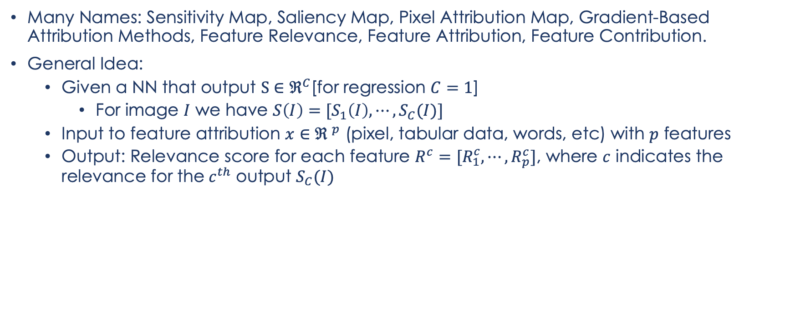
Feature Attribution
Many Names: Sensitivity Map, Saliency Map, Pixel Attribution Map, Gradient-Based Attribution Methods, Feature Relevance, Feature Attribution, Feature Contribution.
General Idea:
Given a NN that output $S∈ℜ^{C}$[for regression $C=1$]
For image $I$ we have $S\left(I\right)=[S_{1}\left(I\right),⋯,S_{C}(I)]$
Input to feature attribution $x∈{ℜ }^{p}$ (pixel, tabular data, words, etc) with $p$ features
Output: Relevance score for each feature $R^{c}=[R_{1}^{c},⋯, R_{p}^{c}]$, where $c$ indicates the relevance for the$c^{th}$ output $S_{C}(I)$

Slide 21
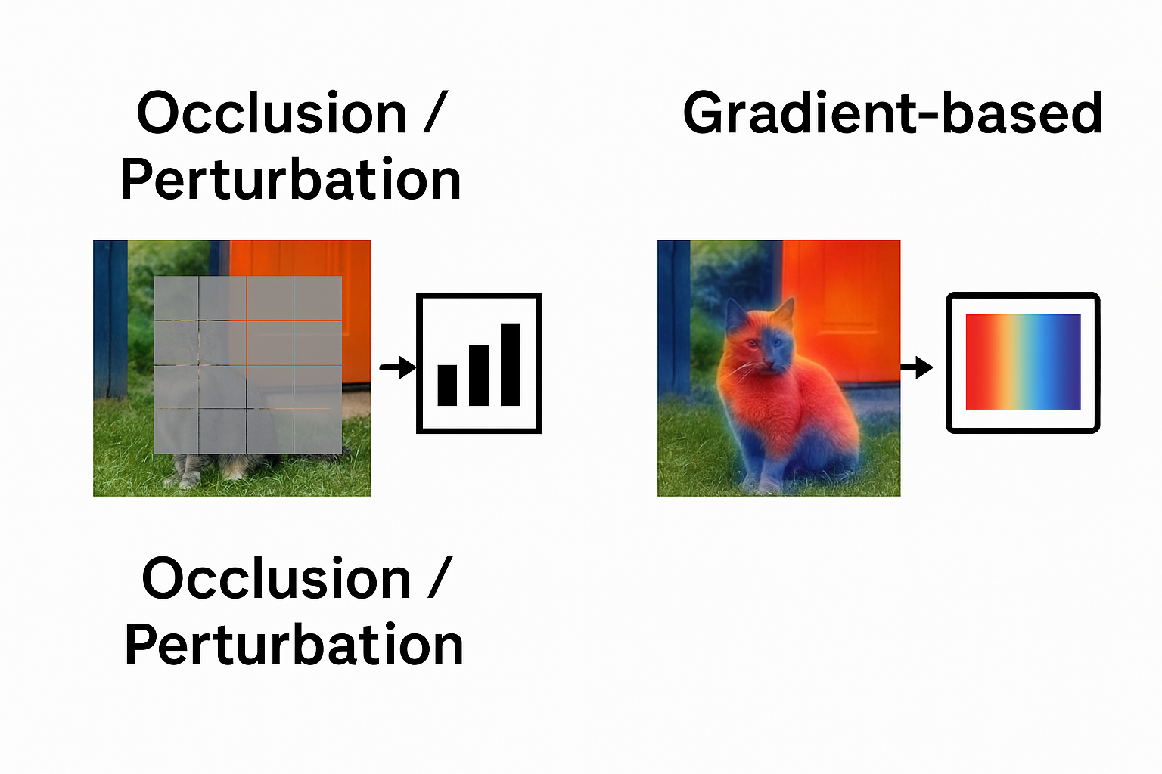
Pixel Attribution
Feature (pixel) attribution: Explains predictions by attributing relevance to each input feature (pixels, tabular data, words).
Two major classes(pixel attribution):
Occlusion / perturbation methods (e.g., SHAP, LIME) explain a model by hiding or altering small regions of the image and observing how the output changes.
Gradient‑based methods (e.g., saliency maps, Guided BP, Grad‑CAM) explain a prediction by back‑propagating the score to the input pixels and visualising the resulting gradients.

Slide 22
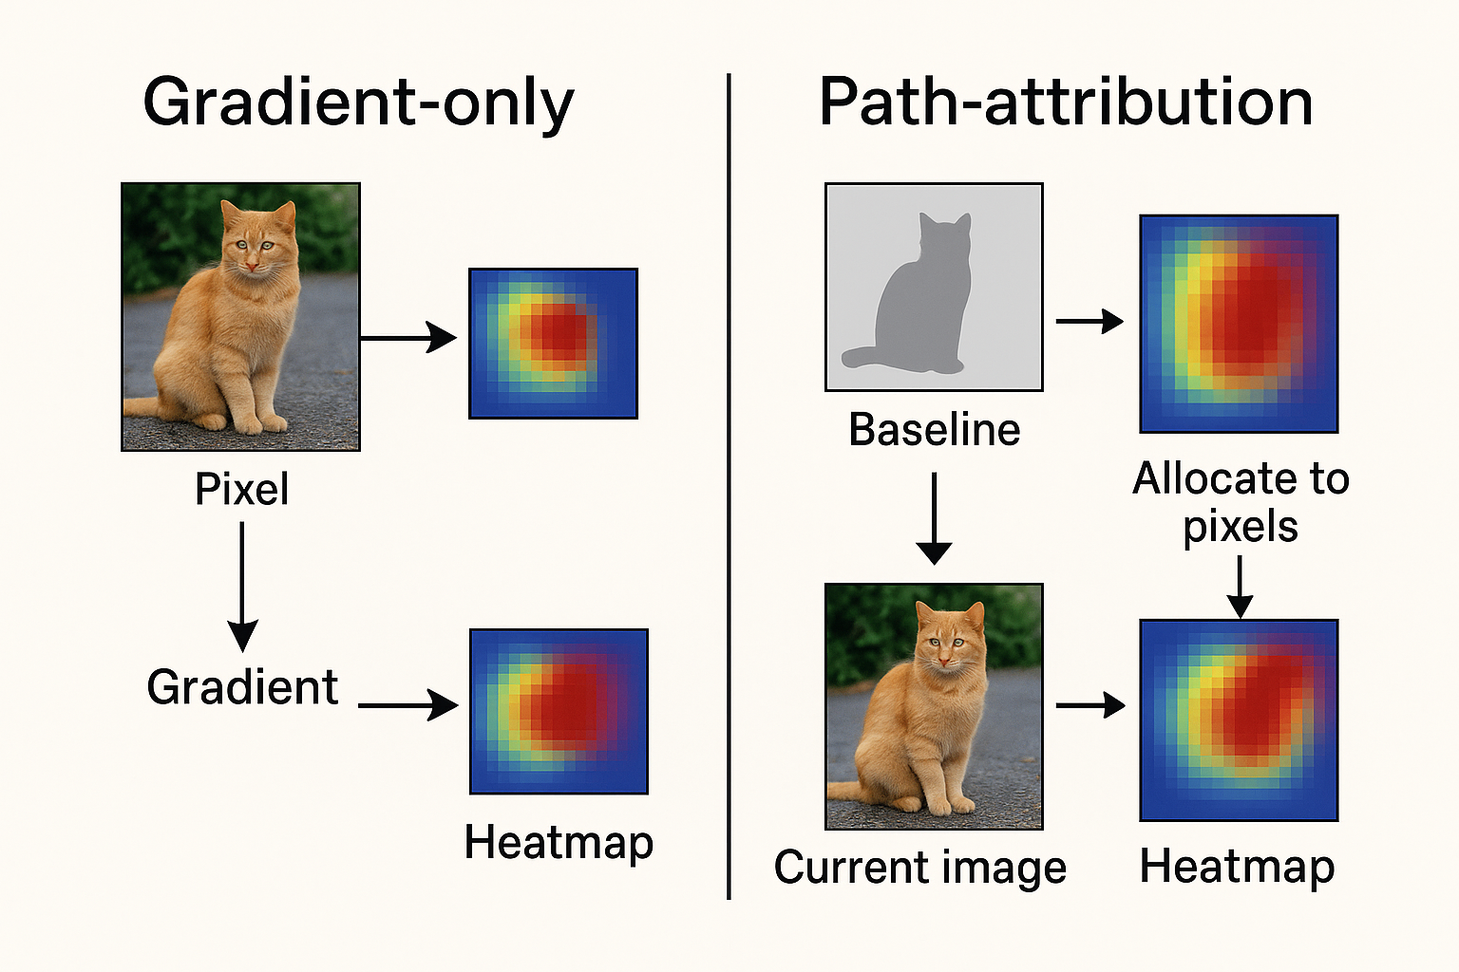
Pixel Attribution
Gradient‑only : Backpropogate once. The heat‑map shows how an infinitesimal change in each pixel would raise (warm colours) or lower (cool colours) the class score.
Examples – Vanilla Gradients, Grad‑CAM.
local sensitivity
Path‑attribution: Compare to a baseline. Subtract the score of a reference image (often a grey “zero” image) from the current score and divide that difference among the pixels.
Examples – Integrated Gradients, Deep Taylor, LIME, SHAP. If the method is complete, the pixel scores sum exactly to the score gap.
contribution relative to a reference.
Both produce a same‑size heat‑map you can overlay on the image.

Slide 23
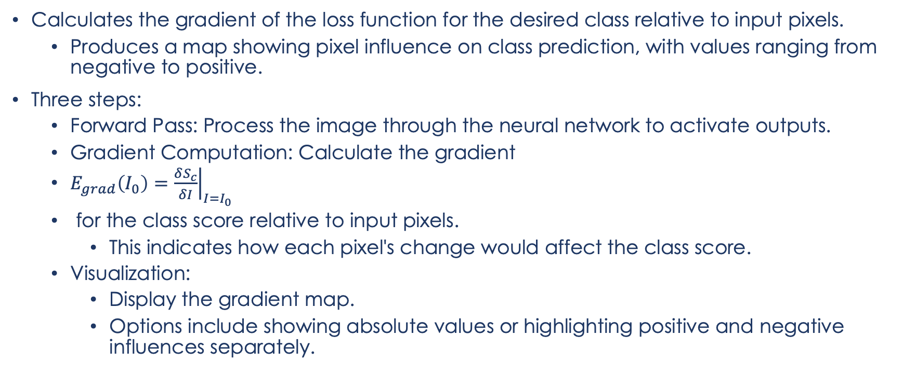
Vanilla Gradient (Saliency Maps)
Calculates the gradient of the loss function for the desired class relative to input pixels.
Produces a map showing pixel influence on class prediction, with values ranging from negative to positive.
Three steps:
Forward Pass: Process the image through the neural network to activate outputs.
Gradient Computation: Calculate the gradient
$E_{grad}\left(I_{0}\right)={\left.\frac{δS_{c}}{δI}\right|}_{I=I_{0}}$​
​ for the class score relative to input pixels.
This indicates how each pixel's change would affect the class score.
Visualization:
Display the gradient map.
Options include showing absolute values or highlighting positive and negative influences separately.

Slide 24
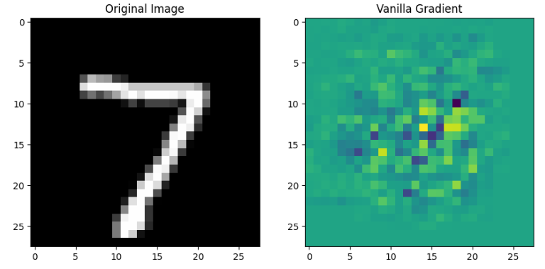
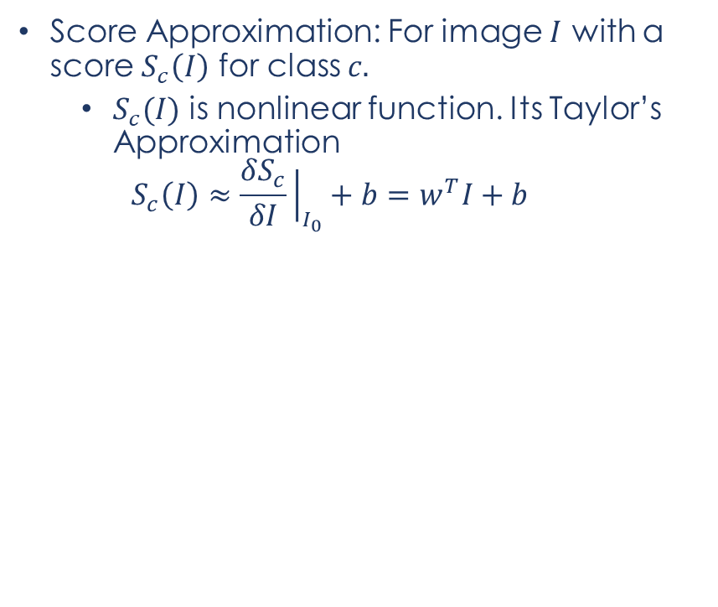
Vanilla Gradient (Saliency Maps)
Score Approximation: For image $I$ with a score $S_{c}\left(I\right)$ for class $c.$
$S_{c}(I)$ is nonlinear function. Its Taylor’s Approximation
$$S_{c}\left(I\right)≈\frac{δS_{c}}{δI}{\left.​\right|}_{I_{0}}+b=w^{T}I+b$$
Notes:
Description of the Images:
Original Image: The left image displays a digit (7) from the MNIST dataset. This is the input image that your model evaluates.
Vanilla Gradient Image: The right image shows the Vanilla Gradient, which visualizes the sensitivity of the predicted class score with respect to each pixel in the input image. The gradient image is color-coded, where different colors indicate the magnitude and direction of the gradient at each pixel.
Interpretation:
Highlighting Pixel Influence: The Vanilla Gradient image highlights which pixels are most influential in determining the class of the digit. Brighter colors (such as yellow) indicate regions with higher sensitivity, meaning changes in these pixel values have a stronger impact on the model's output.
Understanding Model Focus: The gradient map can be used to understand which areas of the image the model is "focusing" on when making a prediction. For the digit '7', the model pays particular attention to the central downward stroke and the top horizontal stroke.
Evaluating Model Behavior: This visualization helps in assessing whether the model is looking at the right features for its predictions. For example, if the gradient highlights irrelevant parts of the image (e.g., the background), it might suggest issues with the model's training or its generalization ability.
Use in Presentations or Analysis:
When presenting or analyzing these images, you might focus on how the Vanilla Gradient can be used as a diagnostic tool to improve model training. It provides insights into the model's decision-making process, which can be crucial for debugging, model improvement, or even for explaining the model's behavior in more understandable terms to non-experts.

Slide 25
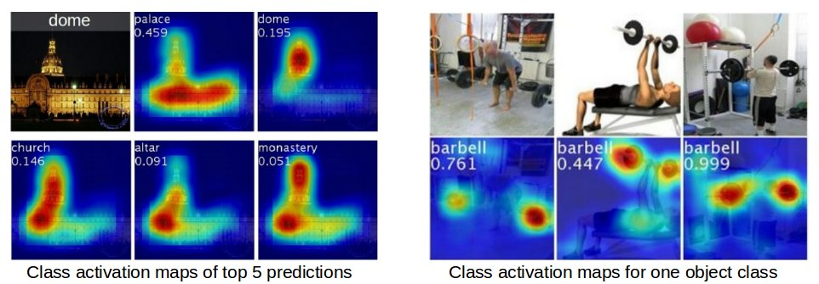
Class Activation Map (CAM)
CAM shows which parts of an image the CNN focuses on to recognize a specific category.

Slide 26
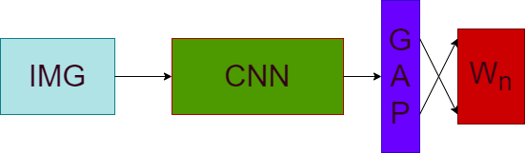
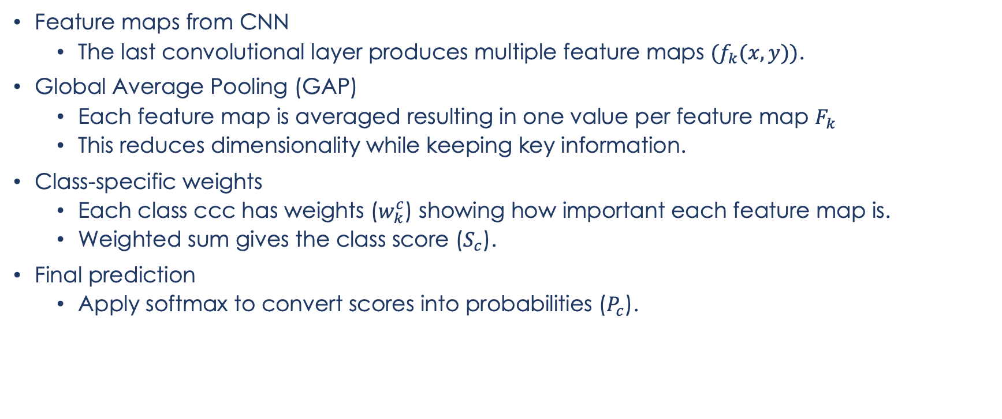
CAM: How it Works?
Feature maps from CNN
The last convolutional layer produces multiple feature maps ${(f}_{k}(x,y))$.
Global Average Pooling (GAP)
Each feature map is averaged resulting in one value per feature map $F_{k}$
This reduces dimensionality while keeping key information.
Class-specific weights
Each class ccc has weights ($w_{k}^{c}$​) showing how important each feature map is.
Weighted sum gives the class score ($S_{c}$​).
Final prediction
Apply softmax to convert scores into probabilities ($P_{c}$​).

Slide 27
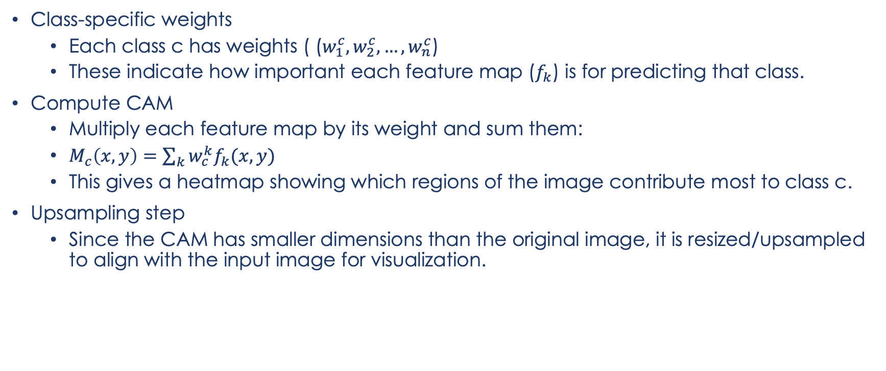
CAM: How it Works?
Class-specific weights
Each class c has weights ( ($w_{1}^{c}, w_{2}^{c}, …, w_{n}^{c}$)
These indicate how important each feature map ($f_{k}$) is for predicting that class.
Compute CAM
Multiply each feature map by its weight and sum them:
$M_{c}\left(x,y\right)=\sum_{k}{w_{c}^{k}f_{k}(x,y)}$
This gives a heatmap showing which regions of the image contribute most to class c.
Upsampling step
Since the CAM has smaller dimensions than the original image, it is resized/upsampled to align with the input image for visualization.

Slide 28
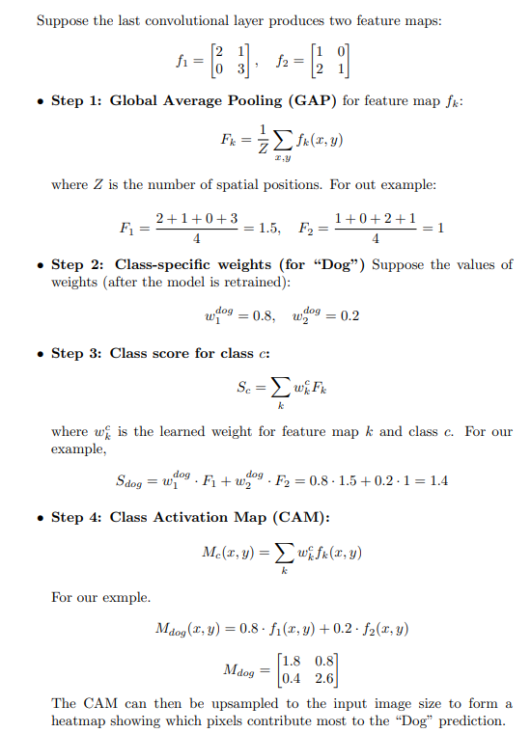
CAM: Simple Example

Slide 29
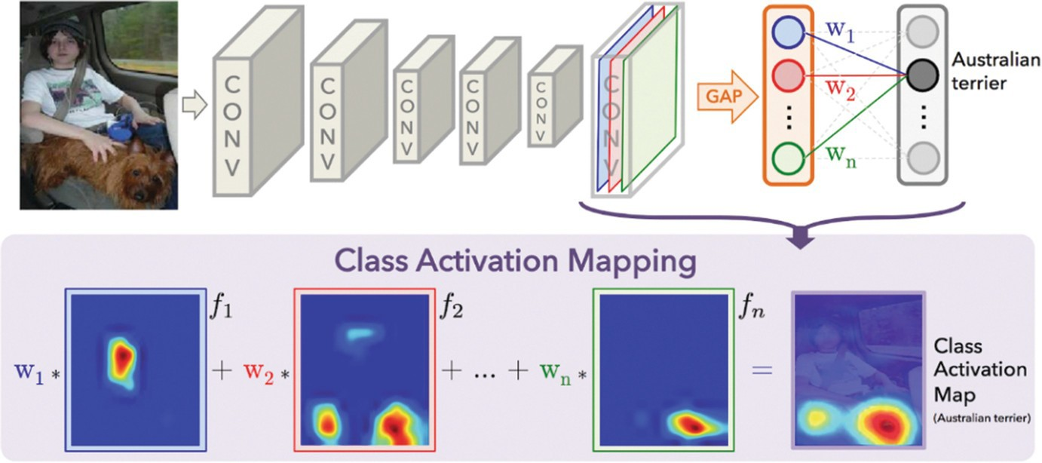
Class Activation Map (CAM)

Slide 30
Gradient Class Activation Map (Grad-CAM)
Uses gradients (not weights) from the last convolutional layer.
No retraining or architectural changes needed.
Use gradients of the class score with respect to feature maps.
Gradients tell us which feature maps are important for the class.

Slide 31
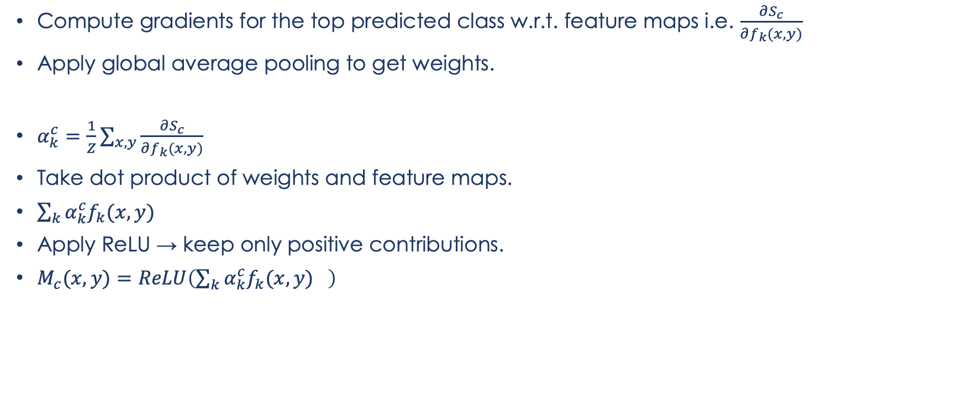
Grad-CAM: Working
Compute gradients for the top predicted class w.r.t. feature maps i.e. $\frac{∂S_{c}}{∂f_{k}(x,y)}$
Apply global average pooling to get weights.
$α_{k}^{c}=\frac{1}{Z}\sum_{x,y}{\frac{∂S_{c}}{∂f_{k}(x,y)}}$
Take dot product of weights and feature maps.
$\sum_{k}{α_{k}^{c}f_{k}(x,y) }$
Apply ReLU → keep only positive contributions.
$M_{c}(x,y)=ReLU\left(\sum_{k}{α_{k}^{c}f_{k}(x,y) }\right)$

Slide 32
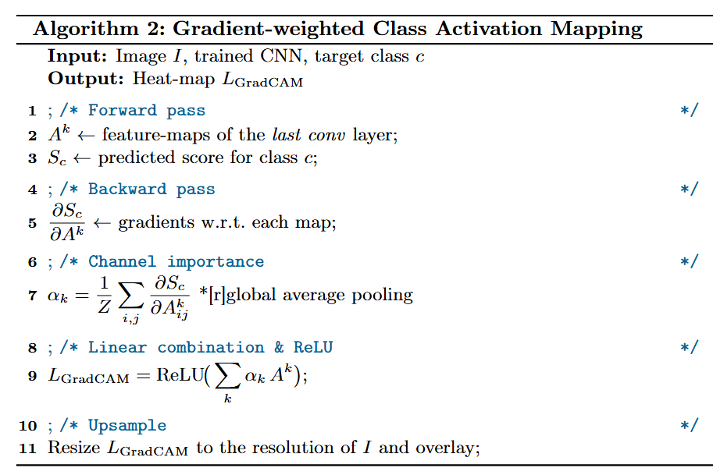
Grad-CAM

Slide 33
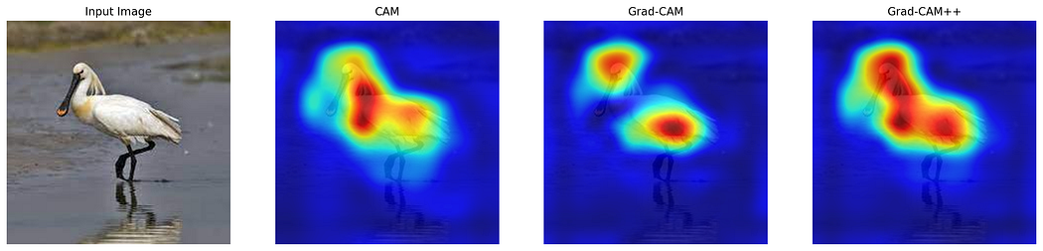
CAM vs GRAD-CAM
https://medium.com/@tanishqsardana/visualizing-how-cnn-thinks-cam-grad-cam-grad-cam-1dabcf886cc5

Slide 34
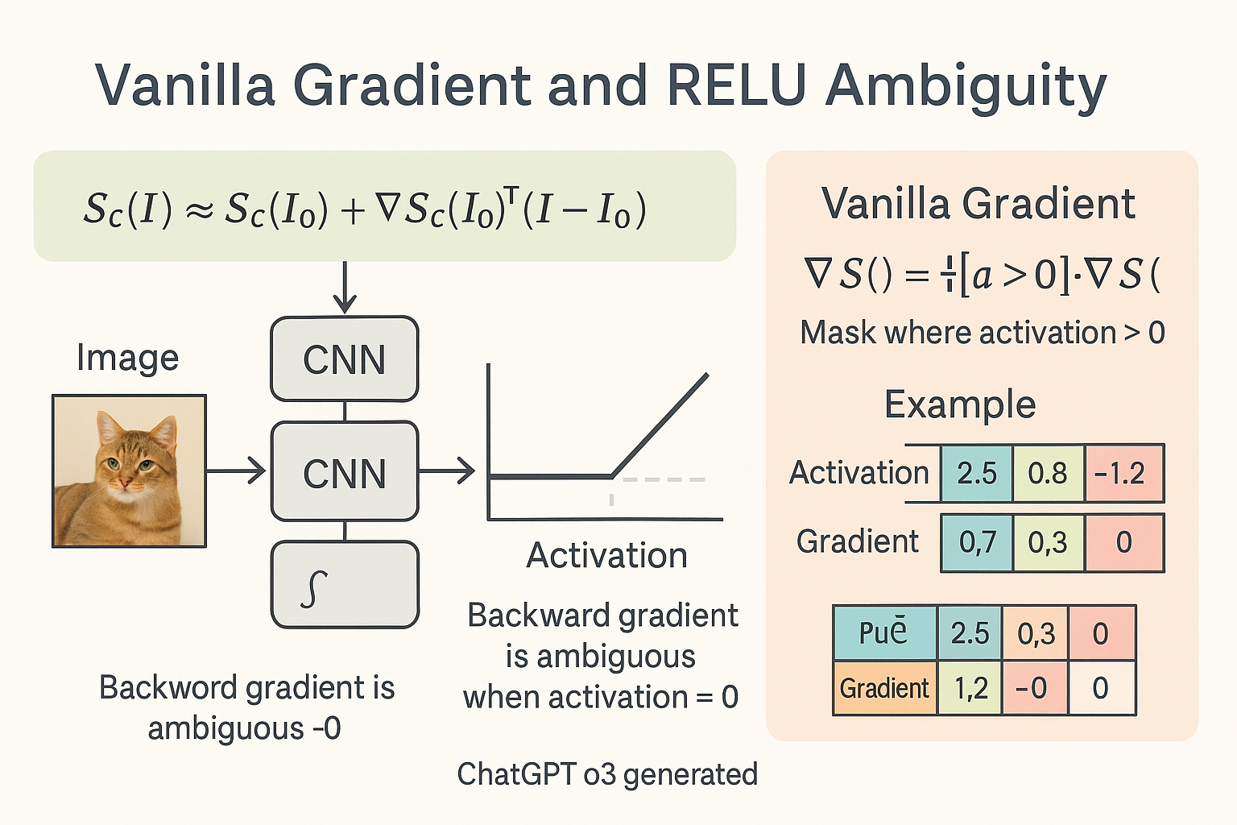

Slide 35
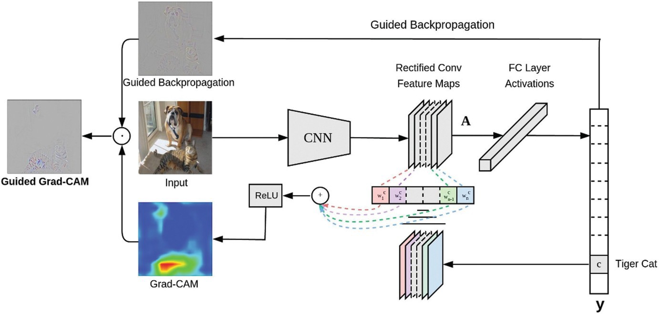
Gradient Class Activation Map (Grad-CAM)
An evolution of the CAM is the Grad-CAM.
Grad-CAM does not retrain the network.
Grad-CAM’s explanations can suffer from gradient problems.

Slide 36
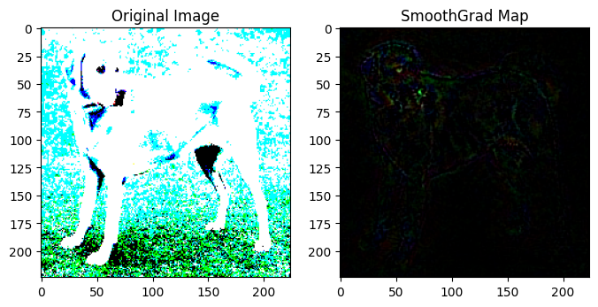
Smooth Gradient
A generic method
Noise Addition: Generate multiple versions of the target image by adding Gaussian noise.
Pixel Attribution: Create pixel attribution maps for each noisy image.
Averaging: Average these maps to produce a smoother, less noisy gradient visualization.
Derivatives in neural networks can be noisy due to small-scale fluctuations.
Averaging over several noisy samples reduces these fluctuations, leading to clearer insights.

Slide 37
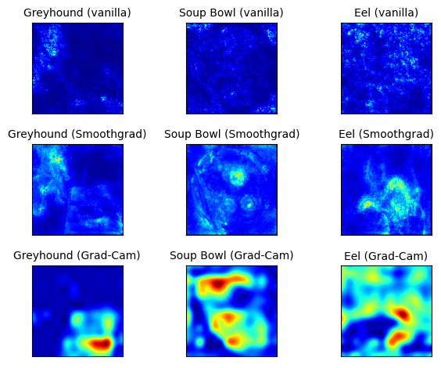
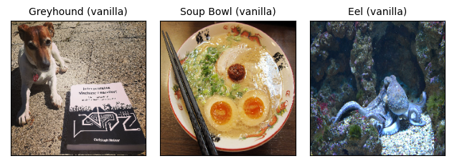
Can we trust these explanations?
Image on the left classified as “Greyhound” with a probability of 35%.
The middle image Correctly identified as “Soup Bowl” with a probability of 50%.
The right image incorrectly classified as “Eel” with a high probability of 70%.
Notes:
How to verify the network was actually looking at these spots to make decision?

Slide 38
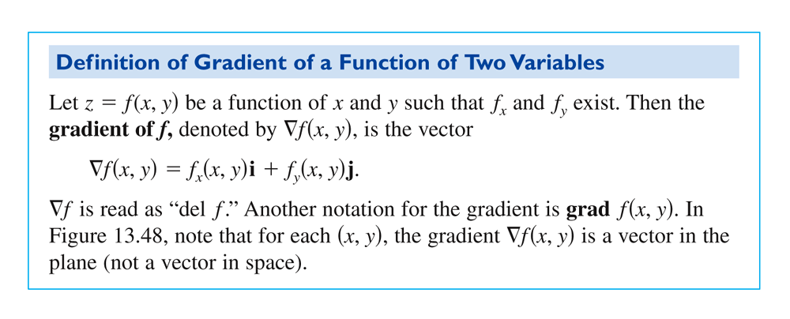
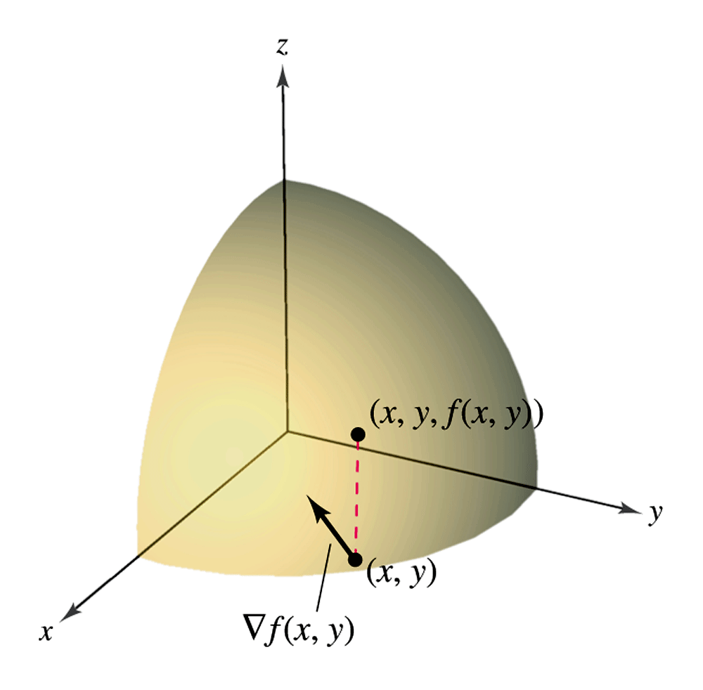
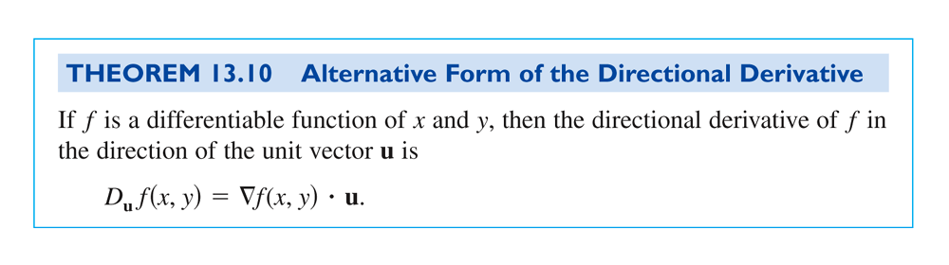

Slide 39
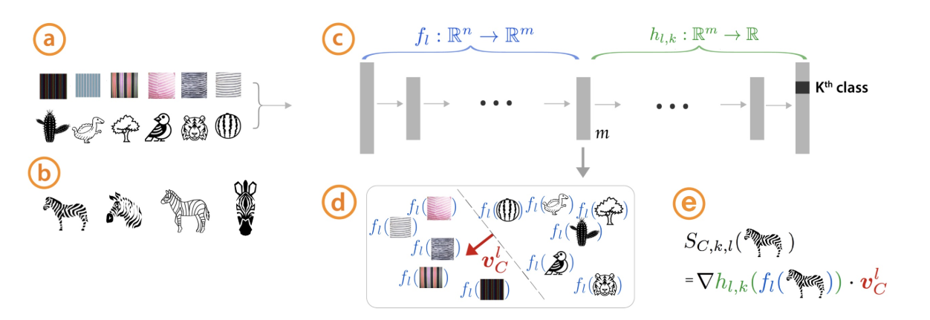
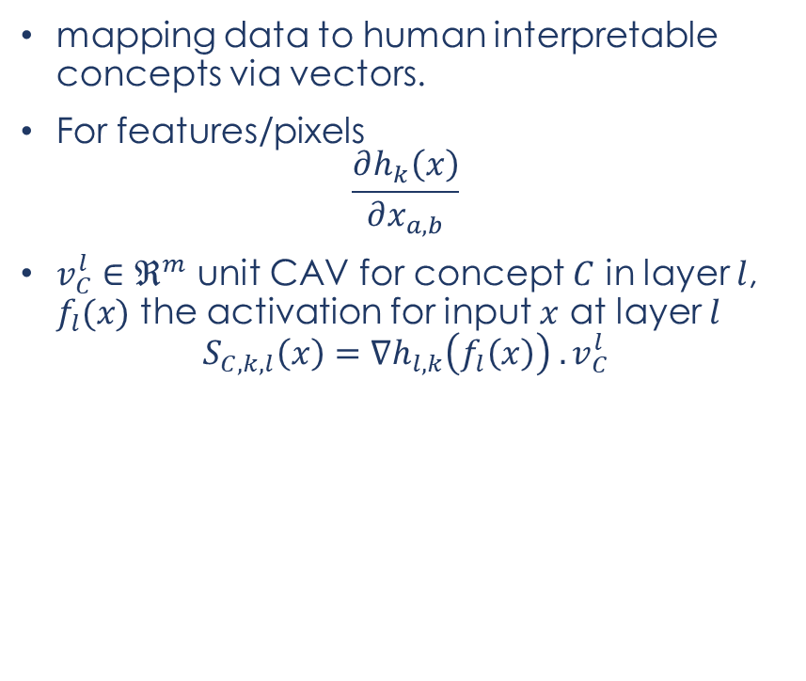
Concept Activation Vectors
mapping data to human interpretable concepts via vectors.
For features/pixels
$$\frac{∂h_{k}\left(x\right)}{∂x_{a,b}}$$
$v_{C}^{l}∈ℜ^{m}$ unit CAV for concept $C$ in layer $l$, $f_{l}(x)$ the activation for input $x$ at layer $l$
$$S_{C,k,l}\left(x\right)=∇h_{l,k}\left(f_{l}\left(x\right)\right) . v_{C}^{l}$$
Source: https://proceedings.mlr.press/v80/kim18d/kim18d.pdf
Notes:
where hk(x) is the logit for a data point x for class k and xa,b is a pixel at position (a, b) in x. Thus, saliency uses the derivative to gauge the sensitivity of the output class k to changes in the magnitude of pixel (a, b).

Slide 40
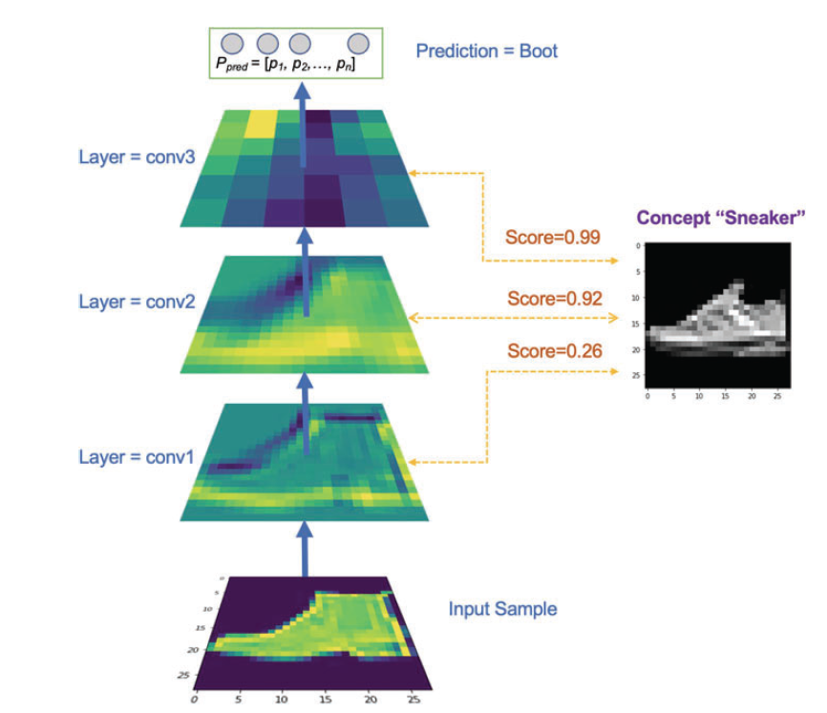
Concept Activation Vectors
Notes:
Here’s a breakdown of the image and how to interpret it:
Input Sample: At the bottom, you see the original input image that the CNN is evaluating. This image is typically pre-processed before being fed into the neural network.
Layer Outputs (conv1, conv2, conv3): Moving up from the input, the image shows the activation maps from three consecutive convolutional layers of the network (conv1, conv2, conv3). These maps illustrate how the network's feature detectors respond at each layer. As you ascend from conv1 to conv3, the activation maps generally become more abstract and less visually interpretable:
conv1: Shows basic feature detection like edges and textures.
conv2: Higher-level features begin to emerge, possibly detecting simple patterns or parts of objects.
conv3: Represents even more abstract features that are further from direct visual interpretation.
Concept “Sneaker”: To the right, there’s an image representing the "Sneaker" concept. This might be a model-generated image or an averaged representation of what the network interprets as a sneaker based on its training on similar images.
Scores by Layer: Next to each layer, there’s a score indicating how strongly the activation patterns in that layer correspond to the concept of a sneaker:
conv1: Score = 0.26 – This low score suggests that the initial layer captures very general features that are not strongly related to the specific concept of a sneaker.
conv2: Score = 0.92 – A high score indicating that this layer captures features highly relevant to the concept of a sneaker.
conv3: Score = 0.99 – The highest score, indicating that the most abstract layer strongly correlates the detected features with the concept of a sneaker.
Prediction: The top of the image shows that the overall prediction of the network is "Boot". This suggests that despite the high relevance of sneaker-related features in higher layers, the final classification output is "Boot".
Interpretation:
This illustration can be used to understand how different layers of a CNN contribute to the final decision, especially in terms of specific concept relevance. It shows that even though the layers recognize sneaker-like features, the cumulative effect of all features leads to a different overall prediction.
It also demonstrates the application of TCAV, where concept activation vectors are used to quantitatively measure how much a concept (like "Sneaker") influences the prediction at each layer.
The network's ability to identify sneaker features but ultimately decide on a different class could be due to overlapping features between classes (e.g., both sneakers and boots may share certain textural or shape characteristics) or due to other dominant features that sway the final classification.

Slide 41
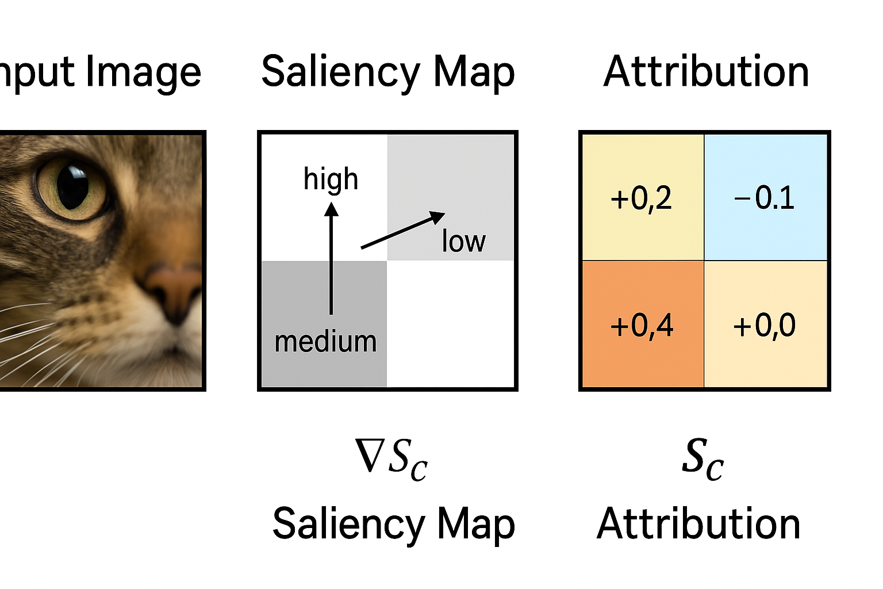
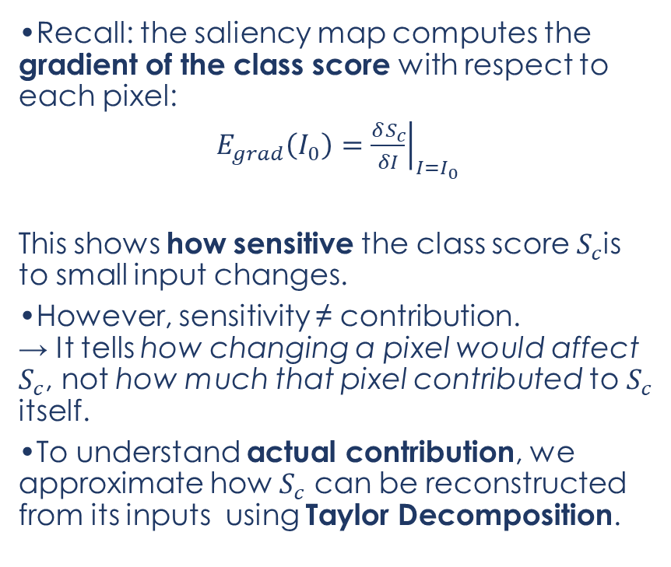
From Saliency Maps to Formal Decomposition
Recall: the saliency map computes the gradient of the class score with respect to each pixel:
$E_{grad}\left(I_{0}\right)={\left.\frac{δS_{c}}{δI}\right|}_{I=I_{0}}$​
This shows how sensitive the class score $S_{c}$is to small input changes.
However, sensitivity ≠ contribution. → It tells how changing a pixel would affect $S_{c}$​, not how much that pixel contributed to $S_{c}$​ itself.
To understand actual contribution, we approximate how $S_{c}$​ can be reconstructed from its inputs using Taylor Decomposition.

Slide 42
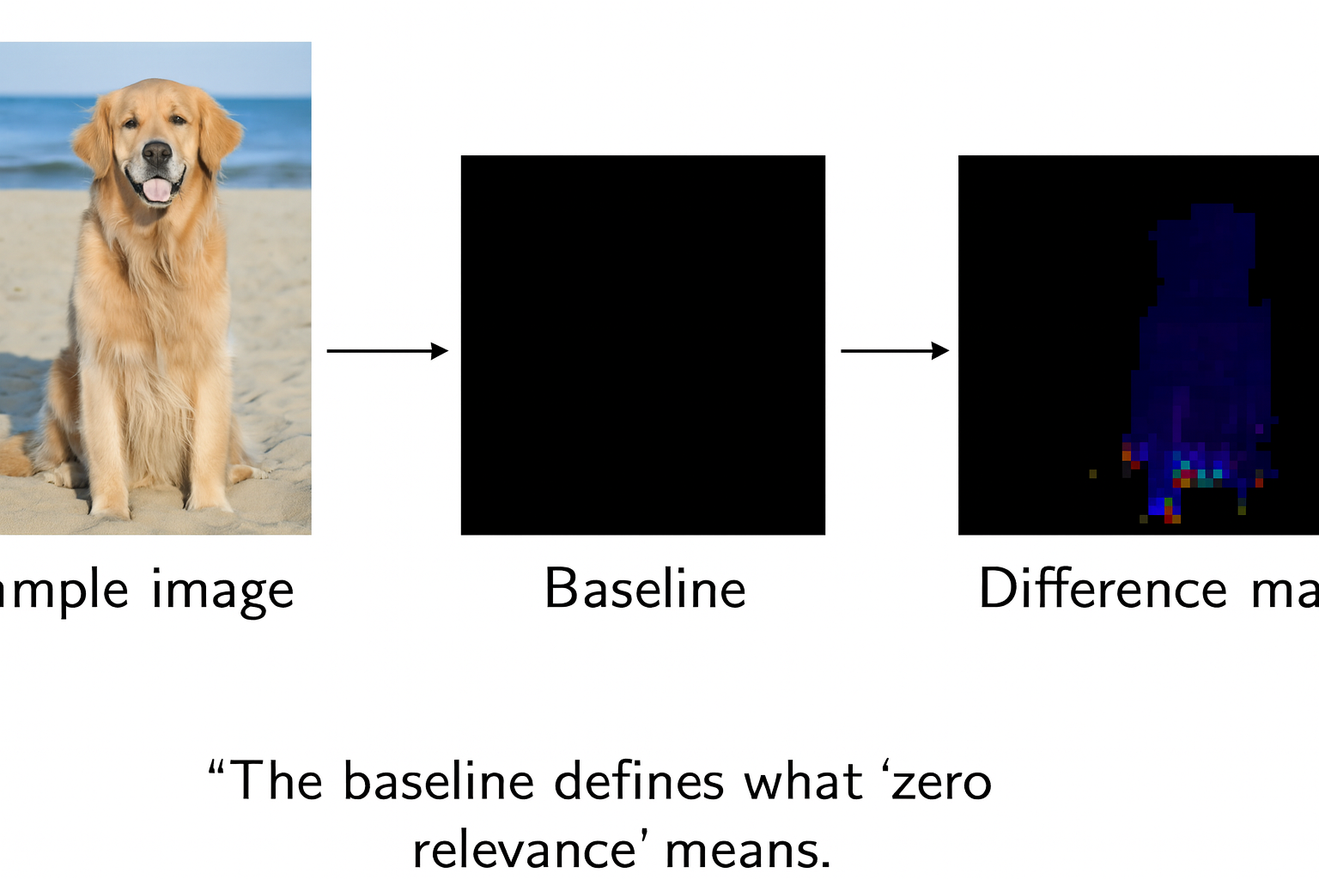
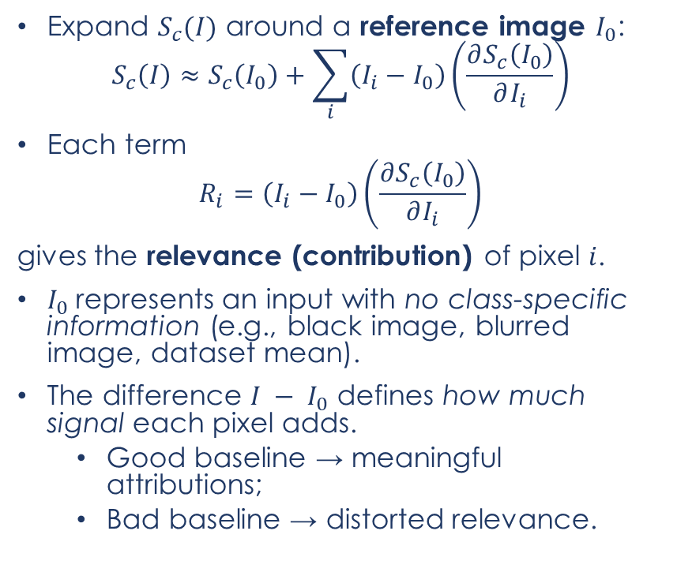
The Taylor Decomposition of the Class Score
Expand $S_{c}(I)$ around a reference image $I_{0}$​:
$$S_{c}\left(I\right)≈S_{c}\left(I_{0}\right)+\sum_{i}{\left(I_{i}−I_{0}\right)}\left(\frac{∂S_{c}\left(I_{0}\right)}{∂I_{i}}\right)$$
Each term
$$R_{i}=\left(I_{i}−I_{0}\right)\left(\frac{∂S_{c}\left(I_{0}\right)}{∂I_{i}}\right)$$
gives the relevance (contribution) of pixel $i$.
$I_{0}​$represents an input with no class-specific information (e.g., black image, blurred image, dataset mean).
The difference $I − I_{0}$​ defines how much signal each pixel adds.
Good baseline → meaningful attributions;
Bad baseline → distorted relevance.

Slide 43
The Taylor Decomposition of the Class Score
Works only locally around $I_{0}$​.
Works only locally around 𝐼_0​.
Deep networks are highly nonlinear — single expansion can’t follow their internal structure.
Doesn’t account for how activations interact across layers.
Explanations can become unstable or noisy.

Slide 44
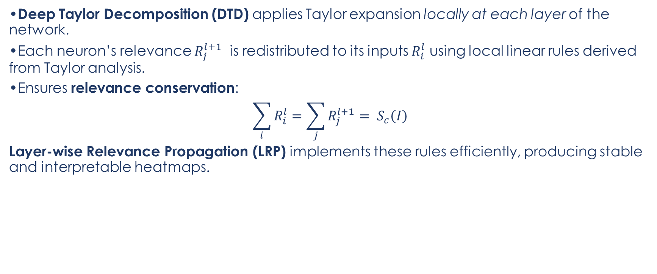
Deep Taylor Decomposition (DTD)
Deep Taylor Decomposition (DTD) applies Taylor expansion locally at each layer of the network.
Each neuron’s relevance $R_{j}^{l+1}$ is redistributed to its inputs $R_{i}^{l}$​ using local linear rules derived from Taylor analysis.
Ensures relevance conservation:
$$\sum_{i}{R_{i}^{l}}=\sum_{j}{R_{j}^{l+1}}= S_{c}\left(I\right)$$
Layer-wise Relevance Propagation (LRP) implements these rules efficiently, producing stable and interpretable heatmaps.

Slide 45
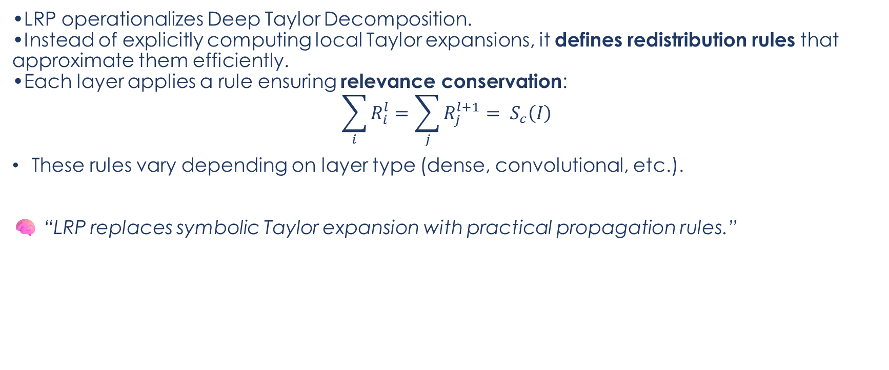
From Deep Taylor to LRP
LRP operationalizes Deep Taylor Decomposition.
Instead of explicitly computing local Taylor expansions, it defines redistribution rules that approximate them efficiently.
Each layer applies a rule ensuring relevance conservation:
$$\sum_{i}{R_{i}^{l}}=\sum_{j}{R_{j}^{l+1}}= S_{c}\left(I\right)$$
These rules vary depending on layer type (dense, convolutional, etc.).
🧠 “LRP replaces symbolic Taylor expansion with practical propagation rules.”
Notes:
Illustration of the LRP procedure. Each neuron redistributes to the lower layer as much as it has received from the higher layer.

Slide 46
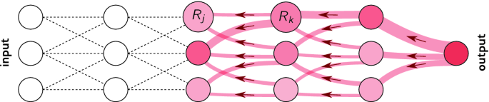
Layer wise relevance propagation
Uses weights and neural activations
Created by forward-pass (i.e. prediction, not training)
Go back from prediction to input
Visualize image pixels which caused high activation
Drawback
only one sample explained

Slide 47
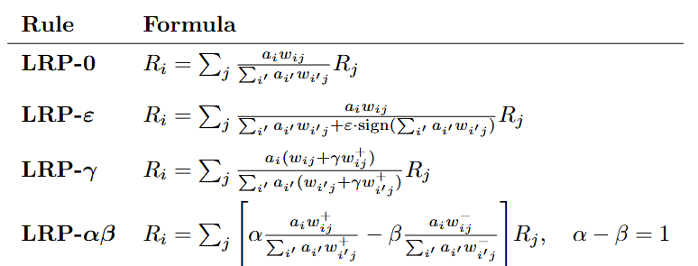
LRP Formulas

Slide 48
Why so many LRP formulas?
Rule | When to Use | Advantage | Limitation / Source
LRP-0 | For simple linear or fully connected layers | Conceptually clear and easy to interpret | Can become unstable when denominators approach zero
LRP-ε | Most commonly used in deep networks | Stabilizes relevance propagation and prevents division by small values | Small ε may blur fine details in heatmaps — Bach et al. (2015, PLOS ONE)
LRP-γ | Convolutional layers (especially with ReLU) | Emphasizes positive (supporting) contributions, sharper explanations | Ignores inhibitory (negative) evidence — Bach et al. (2015)
LRP-αβ | General-purpose; useful when both positive and negative evidence matter | Flexible; allows balancing support and suppression by tuning α, β | Requires parameter tuning (commonly α=2, β=1) — Montavon et al. (2017, Pattern Recognition)

Slide 49
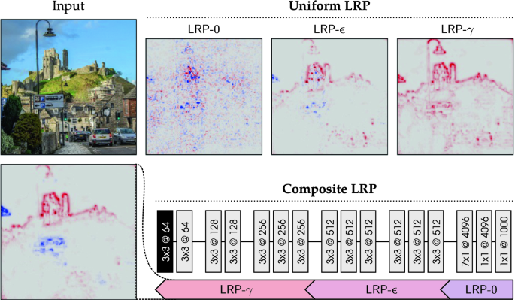
Do we need to apply uniformly?
Instead of using one uniform rule, one can apply different rule to different layers.
https://link.springer.com/chapter/10.1007/978-3-030-28954-6_10

Slide 50
Comparing Explanation Methods
Category | Method | Key Idea | Output Type | Limitation
Feature Visualization | Activation Maximization | Generate input that maximizes neuron/class | Synthetic feature pattern | Not input-specific
Attribution | SHAP / Integrated Gradients | Distribute output over input features | Scalar attribution scores | May violate conservation
Saliency Maps | Vanilla Gradient | Sensitivity of score to input | Gradient map | Local, noisy
Taylor Decomposition | Linear expansion around baseline | Additive local contributions | Per-feature relevance | Not layer-aware
LRP | Layer-wise relevance redistribution | Exact decomposition of class score | Stable, additive heatmap | Depends on rule choice
Notes:
These rules all enforce the same conservation principle — they just differ in how they handle zero-division, sign information, or focus on positive vs negative evidence.

Slide 51
Adversarial Examples
Safety‑critical: stop‑sign spoof → self‑driving car misses the stop.
Security: spam mails engineered to dodge filters.
Physical screening: weapon disguised as umbrella in X‑ray.
Adversarial inputs are a real attack surface, not a lab curiosity.

Slide 52
DeepShap / DeepLift
decomposes the prediction of a single-pixel neural network.
done by carrying out the backpropagation of the contribution of all neurons in the network for each input feature.
DeepLift compares the activation of each neuron with its reference activation and evaluates the importance of each contribution, starting from this difference
This is similar to Shapley Values where the input features are the players in the coalitions, the activation of each neuron is their payment and we are trying find how to split the contribution to the output of the model between the input features

Slide 53
DeepShap / DeepLift

Slide 54
DeepShap / DeepLift
Pros:
Does not rely on gradient, so does not suffer from discontinuous gradients nor zero gradient nodes, nor numerical instability.
Can reveal dependencies hidden in other methods.
Cons:
DeepLift has it’s own activation function, hence requires wither retraining or a surrogate model.
Has to be done for each input feature, for bigger images, this is an issue.

Slide 55
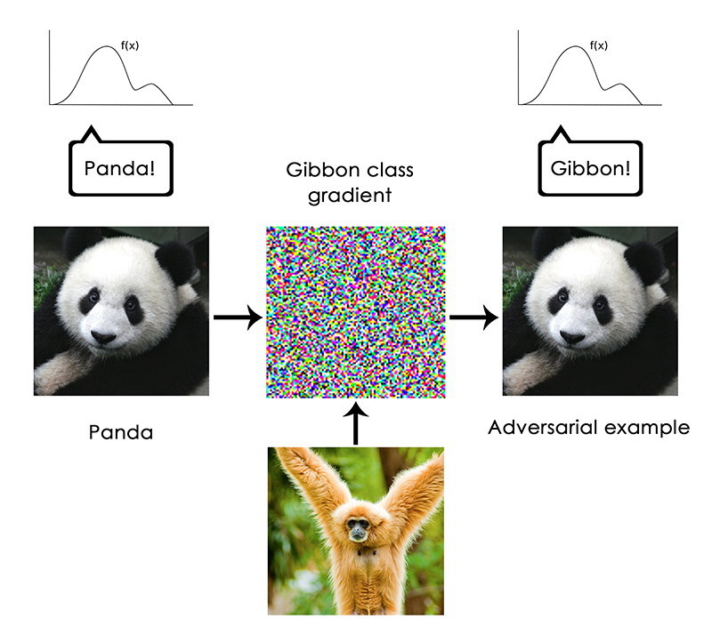
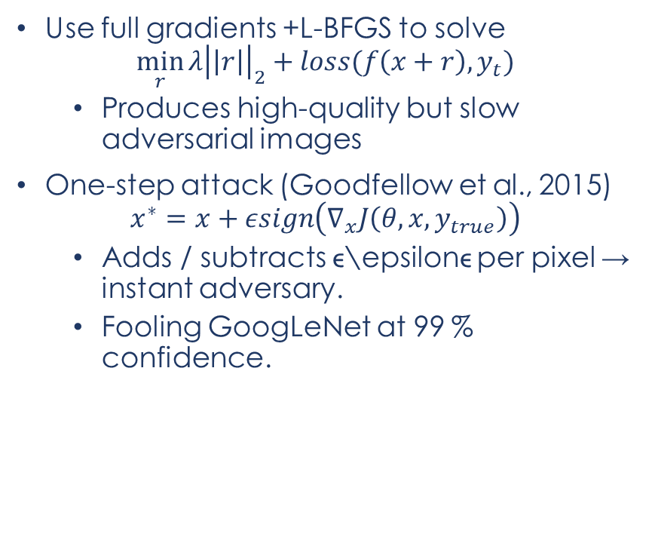
Gradient‑based optimization attacks
Use full gradients +L-BFGS to solve
$$\min_{r}{λ{\left|\left|r\right|\right|}_{2}+loss(f\left(x+r\right),y_{t})}$$
Produces high‑quality but slow adversarial images
One-step attack (Goodfellow et al., 2015)
$$x^{∗}=x+εsign\left(∇_{x}J\left(θ,x,y_{true}\right)\right)$$
Adds / subtracts ϵ\epsilonϵ per pixel → instant adversary.
Fooling GoogLeNet at 99 % confidence.

Slide 56
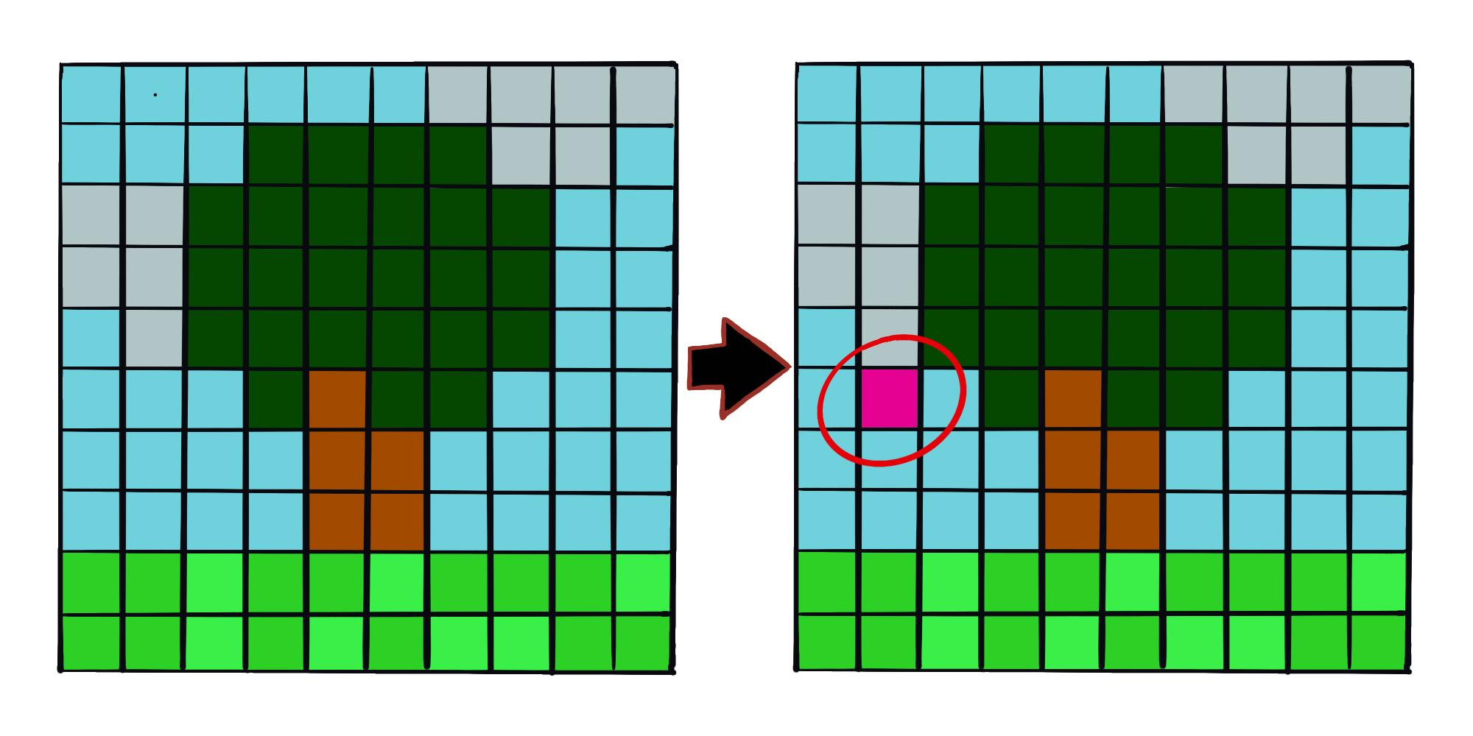
Adversarial Examples
One‑pixel attack (Su et al., 2019): differential evolution finds one RGB pixel that flips the label.
Adversarial patch (Brown et al., 2018): printable sticker forces any scene to be predicted as a toaster – see banana example (third image).
Removes the “imperceptible” constraint; focuses on real‑world deployability.

Slide 57
Why This matters?
Hardening tactics
Adversarial training: iteratively retrain on crafted examples.
Regularisation & robust optimisation (e.g., PGD adversarial training).
Ensembles & randomisation (limited gains).
Proactive testing: treat ML like cyber‑security, seek unknown‑unknowns.
Reality check
No silver bullet; arms race between attackers & defenders.
Interpretability tools help spot fragile features before adversaries do
Notes:
Close by stressing the “three golden rules”: know your adversary, be proactive, protect yourself. Encourage the audience to integrate adversarial testing into their ML workflow.

Slide 58
The present/future…
Focus Area / Method | Key Idea / Improvement | Representative Paper
Transformer-native LRP | Extends LRP and Deep Taylor decomposition to attention layers and transformer blocks | Chefer et al., CVPR 2021, “Transformer Interpretability Beyond Attention Visualization”
Generic Attention Explainability | Unified propagation of relevance in multi-modal and encoder–decoder transformers | Chefer et al., ICCV 2021, “Generic Attention-Model Explainability”
Concept-based Explanations | Learns and attributes human-interpretable concepts (ConceptSHAP, TCAV+) | Ghorbani et al., NeurIPS 2023, “ConceptSHAP: Concept-Based Explanations with Shapley Values”
Diffusion-based Counterfactuals | Uses diffusion models to generate realistic, semantically coherent counterfactuals | Anonymous, CVIU 2024, “Diffusion Models for Counterfactual Explanations (DiME)”
Causally Guided Counterfactuals | Generates counterfactuals consistent with causal structure and avoids spurious correlations | Qiao et al., arXiv 2025, “Causally-Guided Adversarial Steering”
Foundation Model Explainability | Explains large multi-modal and vision–language models (CLIP, ViT) using scalable relevance propagation | Zhang et al., IEEE T-AI 2024, “Explainability for Foundation Models: A Survey”
Refined LRP for Transformers | Adapts LRP rules (ε, γ, αβ) for attention, residual, and normalization layers | Voita et al., TMLR 2023, “LRP in Transformers: Accounting for Residuals and Attention”
Notes:
Trend 1: Transformer-specific explainability — extending classical LRP and saliency to attention mechanisms.
Trend 2: Concept- and counterfactual-based explanations — moving toward human-understandable, semantic reasoning.
Trend 3: Foundation models — scaling XAI methods for CLIP, ViT, and multi-modal transformers.
Trend 4: Ongoing stabilization and rule refinement of LRP in modern architectures.

Slide 59
Funded by the European Union. Views and opinions expressed are however those of the author(s) only and do not necessarily reflect those of the European Union or Horizon Europe: Marie Skłodowska-Curie Actions. Neither the European Union nor the granting authority can be held responsible for them.
This project has received funding from the European Union’s Horizon Europe research and innovation programme under the Marie Skłodowska-Curie grant agreement No. 101119635

